Slide 1
Machine Translation with Large Language Models: Decoder Only vs. Encoder-Decoder
Team: Machine Translators
Mentor: Yash Bhaskar
Abhinav P M, University of Calicut
Sujay Kumar Reddy M, Vellore Institute of Technology, Vellore
C. Oswald, Assistant Professor, National Institute of Technology, Tiruchirappalli.
International Summer School on Natural Language Processing
Project Presentation
IIIT Hyderabad
05 July 2024

Slide 2
Problem Statement
To perform Machine Translation Task with respect to:
Types of LLM: 1. Decoder Only (1-1 and 1-Many) Architecture
2. Encoder-Decoder (1-1, Many-1, 1-Many and Many-Many) Architecture
Objectives:
To investigate on the following:
1. Behaviour of the model with respect to bi-lingual (1-1) and multilingual (Many-1, 1-Many
and Many-Many) language translations
2. Performance of Encoder-Decoder based Transformer models for Neural Machine
Translation (NMT) compared with smaller Decoder-only models, such as LLMs, when
trained using the same data and similar parameters.
3. To quantify the role of context (no. of tokens) in translation with these two
architectures.

Slide 3
Literature Review
Multilingual Machine Translation
Multilingual machine translation with large language models: Empirical results and analysis - Zhu Wenhao et al. (arXiv, 2023) [1]
Massively multilingual neural machine translation - Aharoni et al. (arXiv, 2019) [2]
Massively multilingual neural machine translation in the wild: Findings and challenges - Naveen Arivazhagan et al. (arXiv, 2019) [3]
Learning Resources
BERT - J. Devlin et al. (arXiv, 2018) [4]
Attention - A Vaswani et al. (NeurIPS 2017) [5]

Slide 4
Our Proposed Approaches for Multilingual NMT
1. In-Context Learning (ICL) using Few-Shot Learning
2. Fine-Tuning of LLMs
3. Baseline Model Development from Scratch

Slide 5
1. In-Context Learning (ICL) using Few-Shot Learning

Slide 6
In-Context Learning – How it works?
A way to use language models to learn tasks given only a few examples. [6]
Prompt Engineering Tasks for Few-Shot Learning.
Examples of MT pairs (<X>=<Y>) with a template T, X - Source Sentence, Y - Target Sentence. [1]
In-Context Exemplars:
<X>=<Y> - Strong recipe for best outputs from the model - Wu et al. (2023) [7]
Prompt P = T(X₁,Y₁) ⊕ T(X₂,Y₂) ⊕ ... ⊕ T(X_{n},Y_{n}) where ⊕ - concatenation,
n - number of samples [1]
Wu, Zhenyu, et al. "Openicl: An open-source framework for in-context learning." arXiv preprint arXiv:2303.02913 (2023).

Slide 7
Our Approach - ICL
How a prompt to the model is structured?
- Evaluation:
Low-Resource Languages: Hindi, Telugu, Malayalam, Marathi and Tamil
LLM’s: On 3 sentence pairs using XGLM and MT5.
Metric: BLEU.
{
"1": "After submitting your application, you should receive a registration certificate within several business days. आवेदन जमा करबाक बाद, अहाँकेँ किछु व्यावसायिक दिनक भीतर एक टा पंजीकरण प्रमाण-पत्र भेटि सकैत अछि।"
“2": "Early pregnancy bleeding is usually from a maternal source, rather than a fetal one, प्रारंभिक गर्भावस्था में रक्तस्राव आमतौर पर भ्रूण के बजाय मातृ स्रोत से होता है।", “3": "The bride's father symbolically offers to the bridegroom a cow as a present. एहन रोगीक लेल, जनिक संक्रमण आ कैंसरक नैदानिक संदेह न्यून रहैत अछि, एक्स-रे एकटा कम महग प्रारम्भिक विकल्पक अछि आ प्रयोगशालाक अध्ययनक सङ्ग एकर व्याख्या होइत अछि।",
}

Slide 8
Datasets
BPCC Wiki MT Dataset [9]:
- 16k – 50k Translation Samples.
- English to 22 Indian Language Pairs.
- Context Length of each sentence pair is 40-200 characters long.

Slide 9
In-Context Learning – Experimentation Results (1/2)
Models Chosen:
1. Decoder Only - XGLM
Why? Generates moderate translation with 500 million parameters,
Builds bi-lingual mapping between non-English to English. [1]
2. Encoder-Decoder - mT5
Why? Capability for multilingual translation (mT5-base),
Contains 300 million parameters.
Reference | Predicted (mT5) | Predicted (XGLM)
▁After ▁sub mitting ▁your ▁application , ▁you ▁should ▁receive ▁a ▁registration ▁certificate ▁within ▁several ▁business ▁days . | ▁अपना ▁आवेदन ▁जमा ▁करने ▁के ▁बाद, ▁आपको ▁कई ▁व्यावसायिक▁ दिनों ▁के ▁भीतर ▁पंजीकरण ▁प्रमाणपत्र ▁प्राप्त होना ▁चाहिए। ▁हिंदी में | ▁आवेदन ▁जमा ▁कर बा क ▁बाद , ▁अ हाँ के ँ ▁कि छु ▁व्यावसायिक ▁दिन क ▁भीतर ▁एक ▁टा ▁पं जी करण ▁प्रमाण - पत्र ▁भेट ि ▁सक ै त ▁अ छि ।

Slide 10
In-Context Learning – Experimental Results (2/2)
Language-Pair | BLEU - Decoder Only | BLEU - Encoder-Decoder
eng-hin | 1.096078 | 1.04442
hin-eng | 0.443236 | 0.384031
eng-tel | 0.307206 | 0.292951
tel-eng | 0.379685 | 0.378953
eng-tam | 0.307206 | 0.292951
tam-eng | 0.349053 | 0.364626
eng-mal | 0.307206 | 0.292951
mal-eng | 0.330114 | 0.364626
Implementation Courtesy: https://github.com/NJUNLP/MMT-LLM

Slide 11
2. Fine-Tuning of LLMs

Slide 12
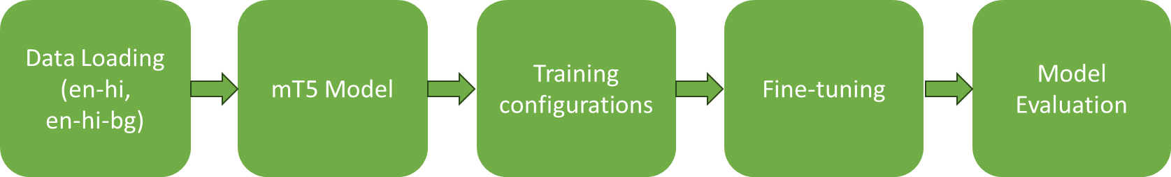
Work Flow of Encoder-Decoder Model: mT5 Fine-Tuning
1-1 Task : ‘en-hi’ from BPCC-Wiki dataset [9]
1-Many Task: ‘en-hi-bg’ from ALT dataset [8]
Figure 1. Work Flow of mT5 Fine-Tuning

Slide 13
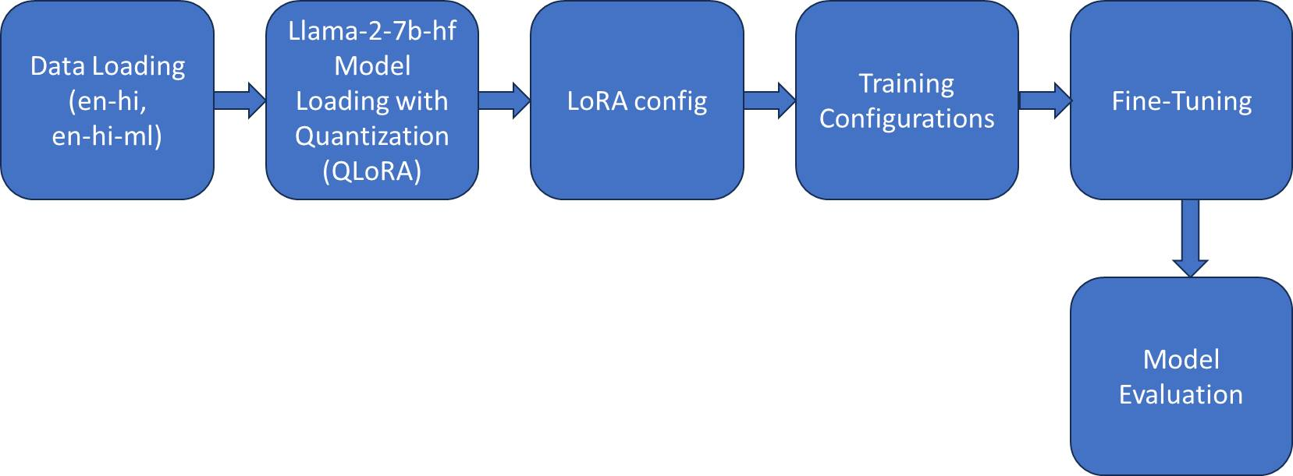
Work Flow of Decoder-Only Model: Llama2 Fine-Tuning
The following prompt template is used for translation tasks:
For English to Hindi: source text #hi#> target text.
#hi#> - indicates the target language.
Figure 2. Work Flow of LlaMA2 Fine-Tuning

Slide 14
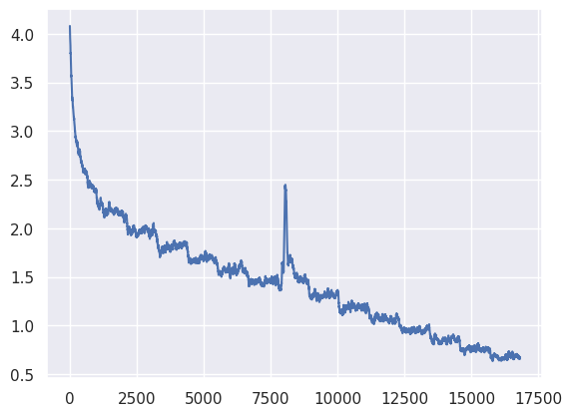
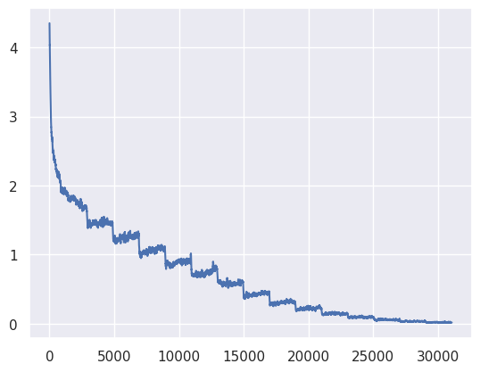
Experimental Results: mT5 Fine-Tuning
Loss
Loss
Iterations
Iterations
Figure 3. mT5 Multilingual (en-hi-bg)
Figure 4. mT5 Bi-lingual (en-hi)

Slide 15
Experimental Results: Llama2 and mT5 Fine-Tuning
Model | BLEU | chrF | TER
Llama2-finetuned-one-many(en-hi) | 0.0265 | 7.1217 | 94.0950
Llama2-finetuned-one-many(en-ml) | 0.0409 | 6.8530 | 96.4312
Llama2-finetuned-one-one(En-Hi) | 0.0955 | 9.2282 | 90.4864
mT5-bi-lingual(en-hi) | 11.7107 | 31.0639 | 74.1626
mT5-bi-lingual(hi-en) | 14.1444 | 33.8278 | 74.7157
mT5 many-many(en-hi) | 3.4802 | 19.6184 | 84.7821
mT5 many-many(en-bg) | 1.0885 | 16.2382 | 91.9398
mT5 many-many(hi-bg) | 0.7545 | 15.6990 | 92.9326
mT5 many-many(hi-en) | 5.2237 | 23.2258 | 84.6685
mT5 many-many(bg-en) | 3.9469 | 21.5855 | 86.7228
mT5 many-many(bg-hi) | 2.1458 | 16.9235 | 88.2083

Slide 16
Sample Results: mT5 Fine-Tuning (1/2)
Model | Type | Source Text | Translated Text | Target Text
mT5 | Bi-Lingual | यह किताब मुझे बहुत पसंद है। | This book I really like. | I like this book very much.
 |  | He loves his parents. | वह अपने माता-पिता को पसंद करती है। | वह अपने माता-पिता से प्यार करता है.
mT5 | Many-Many | He loves his parents. | उसे अपने माता-पिता की प्यास है। | वह अपने माता-पिता से प्यार करता है.
 |  | He has bought a new car. | তিনি একটি নতুন গাড়ি কিনে কিনেছেন। | তিনি একটি নতুন গাড়ি কিনেছেন।
 |  | यह किताब मुझे बहुत पसंद है। | This book is very suitable for me. | I like this book very much.
 |  | वह अपने माता-पिता से प्यार करता है। | তিনি তার বাবার কাছে খুবই পছন্দ করেন। | সে তার বাবা-মাকে ভালোবাসে।
 |  | তুমি কেমন আছো? | तुम कौन हो? | आप कैसे हैं
 |  | আমি আজকে বাসায় থাকব। | I will be at home today. | I will stay at home today.

Slide 17
Sample Results: mT5 Fine-Tuning (2/2)
Model | Type | Source Text | Translated Text | Target Text
Llama2 | 1-Many | Kerala, a state on India's tropical Malabar Coast | ഇന്ത്യയിലെ മലബാർ കോ | ഇന്ത്യയുടെ ഉഷ്ണമേഖലാ മലബാർ തീരത്തുള്ള ഒരു സംസ്ഥാനമാണ് കേരളം
 |  |  | 'भारत की तटीय मलबार कोष्ठ' | केरल, भारत के उष्णकटिबंधीय मालाबार तट पर स्थित एक राज्य
Llama2 | 1-1 | Hello, what is your name? | नमस्ते, आपका नाम क्या है? | नमस्कार, आपका नाम क्या है?
 |  | Today is my birthday | आज मेरी जन्मदिन है | आज मेरा जन्मदिन हे
 |  | Click the "Search" button to begin the search | खोज करने के लिए "खोज" बटन क | खोज शुरू करने के लिए "खोजें" बटन पर क्लिक करें

Slide 18
Analysis: Llama2 and mT5 Fine-Tuning
mT5 is trained with 32,216 data points for the English to Hindi (en-hi) pair.
Reason: Increased data.
For the decoder-only model (Llama2 finetuned), it performs poorly on 1-Many tasks.
For 1-1 tasks, the Llama2 finetuned model performs better compared to the Llama2 1-Many model.
Reason: Llama2 needs to be trained with more high-quality data.

Slide 19
3. Baseline Model Development from Scratch

Slide 20
Challenges so, far …
Pre-trained models are trained on large data. For example: mT5
Now,
To compare the Encoder-decoder and decoder-only models with similar training setting to evaluate the model’s performance in the multi-task learning paradigms.
To compare the context length of both the models by some quantitative metrics which provides some Interpretation of the models.

Slide 21
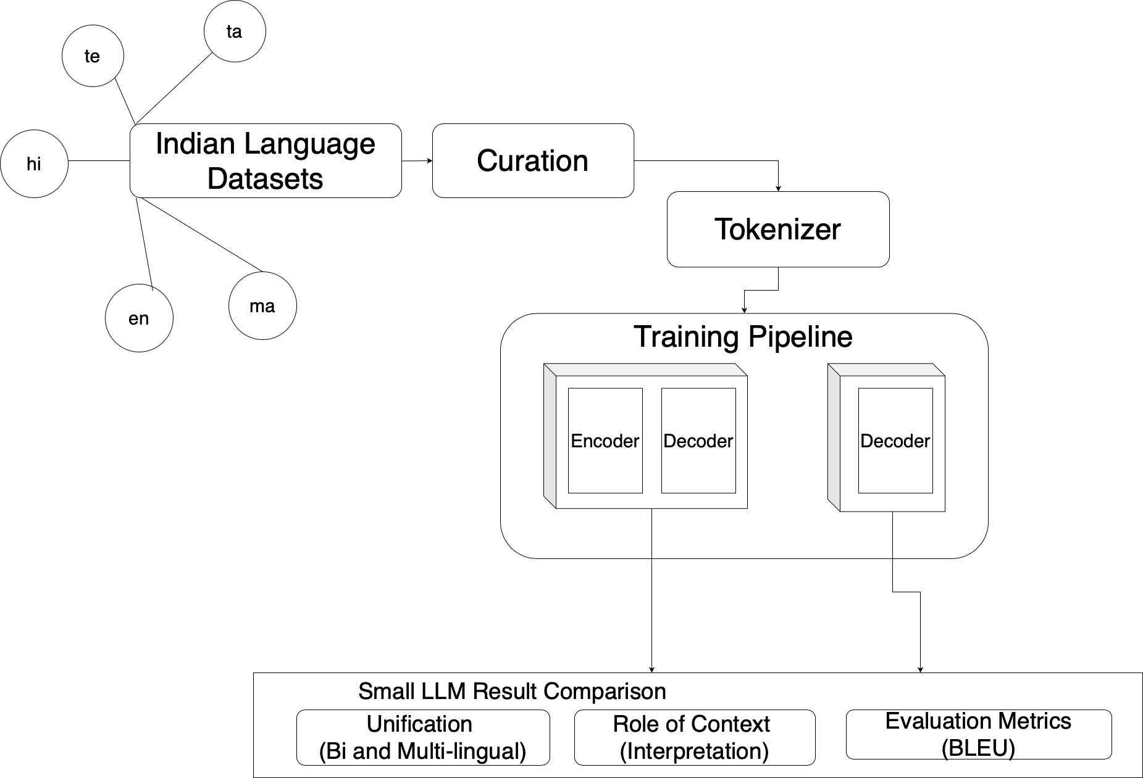
Proposed Methodology of our Baseline Model Development
Figure 2. Proposed Methodology of our Baseline Model Development

Slide 22
Baseline Model Development
To train a model from scratch - Pretrained model is more black boxed and less interpretable.
Took stable baseline models and equated the parameters.
Decoder-Only Model - XLNet as a base model (Wu et al., 2021) [10]
Encoder-Decoder model - IndicBART as a base model (Dabre et al., 2021) [11]
Tokenizer is shared across both the architectures.
Model Name | Trainable Parameters
XLNet Baseline | 147,490,318
Indic-BART Baseline | 145,339,392
Gitub Baseline Implementation : https://github.com/sujaykumarmag/iasnlp

Slide 23
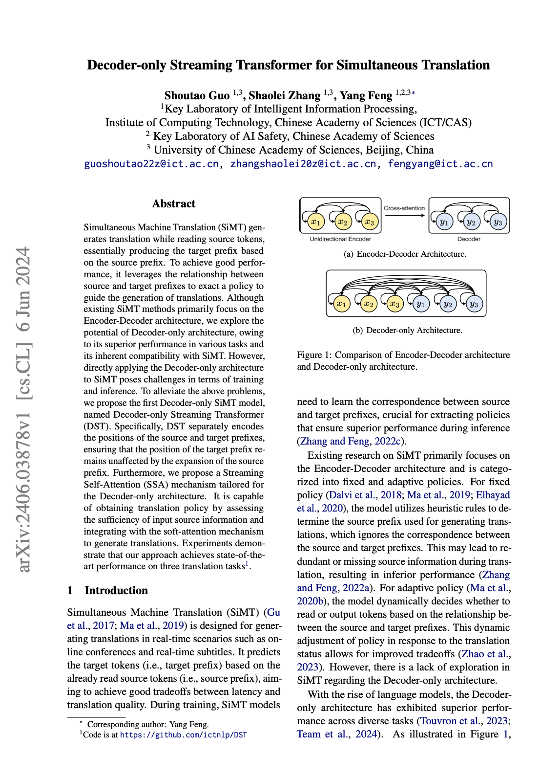
Take Aways and Future Prospects
Encoder-Decoder model provides trustable results, while the Decoder-only models are trained differently as next word/char.
The learning paradigms for both the Architectures are different:
How do we converge for Multilingual Machine Translation?
The Decoder-only model treats the starting tokens of the source text and the translated text separately.
A recent new method - Streaming Self-Attention (SSA) helps the model decide when it has enough of the original text to start translating accurately.
Guo, Shoutao, Shaolei Zhang, and Yang Feng. "Decoder-only Streaming Transformer for Simultaneous Translation." arXiv preprint arXiv:2406.03878 (2024).

Slide 24
References
Zhu, Wenhao, et al. ”Multilingual machine translation with large language models: Empirical results and analysis.” arXiv preprint arXiv:2304.04675 (2023).
Aharoni, Roee, Melvin Johnson, and Orhan Firat. "Massively multilingual neural machine translation." arXiv preprint arXiv:1903.00089 (2019).
Arivazhagan, Naveen, et al. "Massively multilingual neural machine translation in the wild: Findings and challenges." arXiv preprint arXiv:1907.05019 (2019).
Devlin, Jacob, et al. "Bert: Pre-training of deep bidirectional transformers for language understanding." arXiv preprint arXiv:1810.04805 (2018).
Vaswani, Ashish, et al. "Attention is all you need." Advances in neural information processing systems 30 (2017).
https://ai.stanford.edu/blog/understanding-incontext/
Wu, Zhenyu, et al. "Openicl: An open-source framework for in-context learning." arXiv preprint arXiv:2303.02913 (2023).
https://huggingface.co/datasets/mutiyama/alt
https://ai4bharat.iitm.ac.in/bpcc/
Wu, Nier, et al. "Low-Resource Neural Machine Translation Using XLNet Pre-training Model." Artificial Neural Networks and Machine Learning–ICANN 2021: 30th International Conference on Artificial Neural Networks, Bratislava, Slovakia, September 14–17, 2021, Proceedings, Part V 30. Springer International Publishing, 2021.
Dabre, Raj, et al. "IndicBART: A pre-trained model for indic natural language generation." arXiv preprint arXiv:2109.02903 (2021).

Slide 25
Acknowledgements
IIITH Administration for the excellent resource and amenities
IASNLP Coordinators – Dr. Parameswari and Dr. Rahul Mishra
Our Mentor: Mr. Yash Bhaskar
Pre-school Speakers: Prashanth Kodali, Aparajitha, Priyanka Dasari, Aadya Ranjan, Sankalp Bahad

Slide 26
Thank you for your attention

